Slide 1
Netzwerk Academy
Machine Learning
By
Navya Raj

Slide 2
Supervised Learning
Classification | Regression
KNN | KNN
Logistic Regression
______ | Linear Regression
Support Vector machine | Support Vector machine
Decision Tree | Decision Tree
Random Forest | Random Forest
Ensemble | Ensemble

Slide 3
Representation Of data
D = { Xi , Yi}
Label(Yi)
Features(Xi)

Slide 4
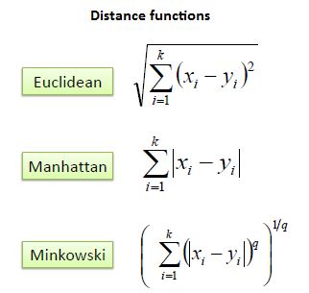
How distance is calculated?

Slide 5
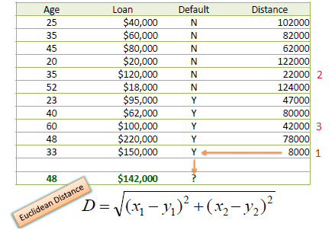
Example

Slide 6
K Nearest Neighbor

Slide 7
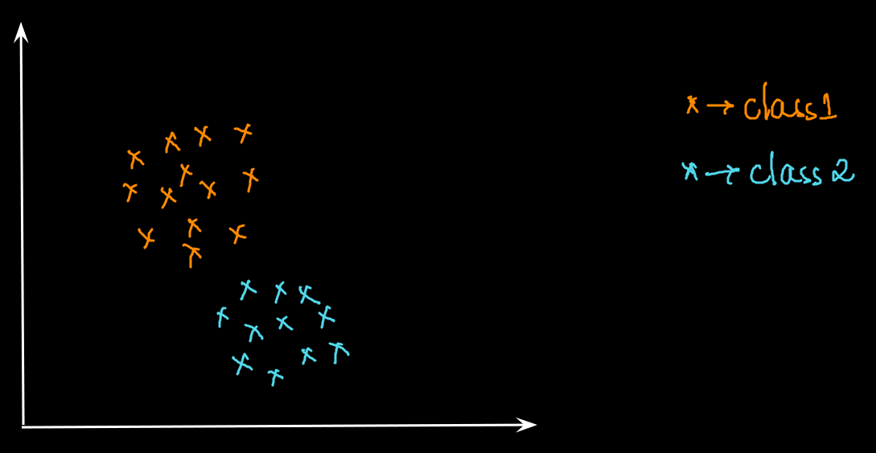
How KNN works?

Slide 8
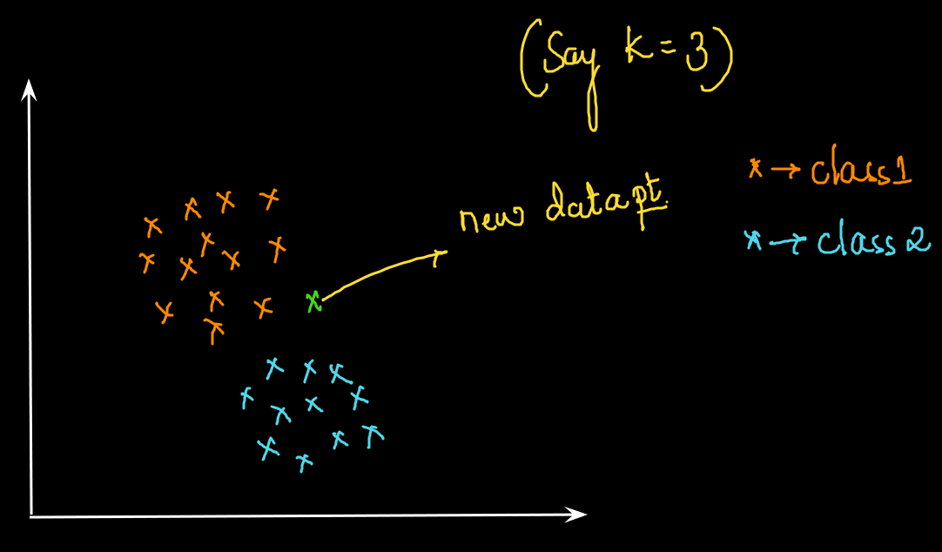
How KNN works?

Slide 9
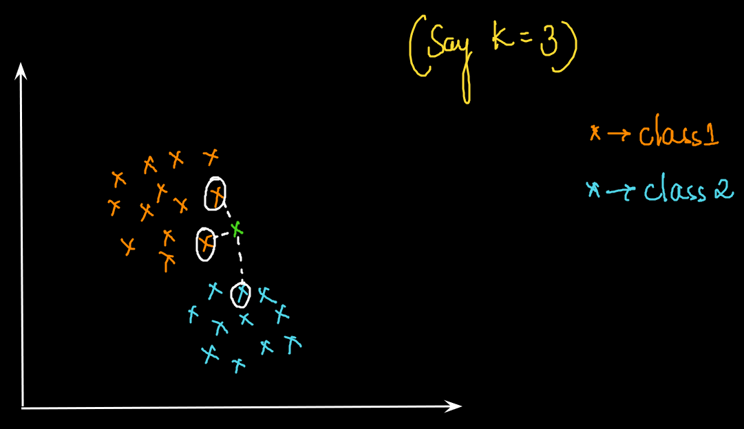
How KNN works?

Slide 10
KNN algorithm
K Nearest Neighbour is classification algorithm based on the training data
Will set K value and calculate the Euclidean distance of the point with the other data points to get K nearest neighbours
Once the distance is calculated, the class with more number of data points is assigned to the new data point

Slide 11
KNN algorithm
Select a k value
For a new data point, distance of a new data point with all other existing data points is calculated
Sort the distances
Based on selected k value, select k smallest distances
Based on majority voting, assign the new data point to the majority class

Slide 12
Drawback of KNN:
K value is always in Odd No because if k is even then situation might come where There is a combination of 2 Classes.
When all classes data points are Mixed.
In Case of Outliers
In case of Imbalance data Set KNN will be biased w.r.t one kind of output.

